Slide 1
Axios

Slide 2
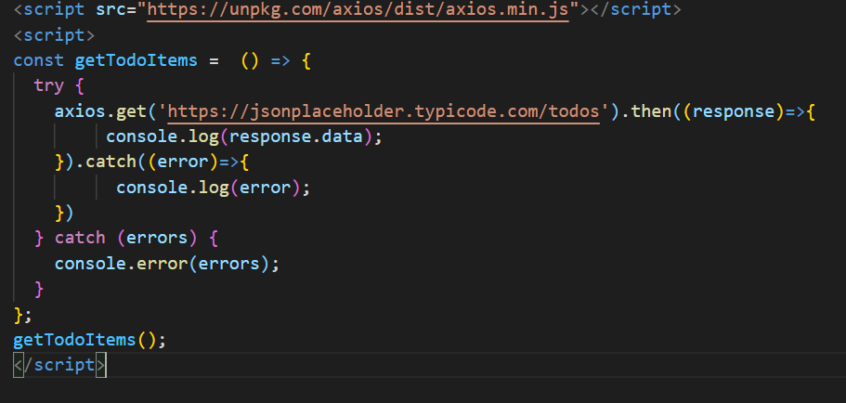
Get Method

Slide 3
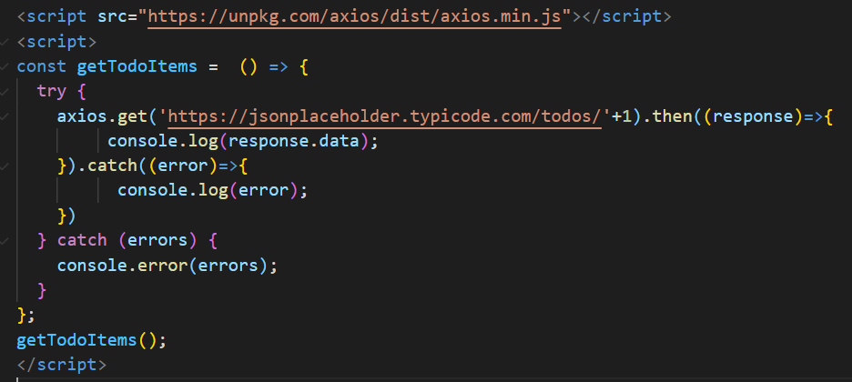
Get Method with dynamic params

Slide 4
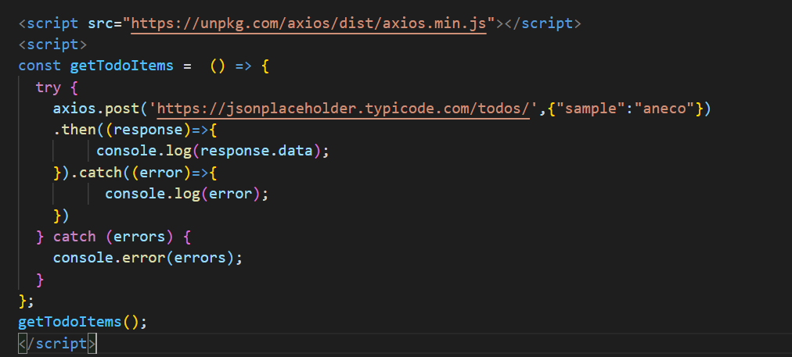
Post Method with body

Slide 5
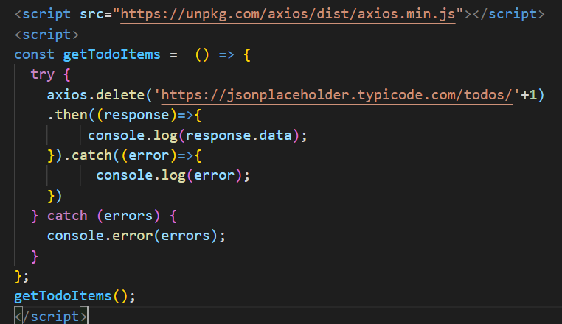
Delete Method

Slide 6
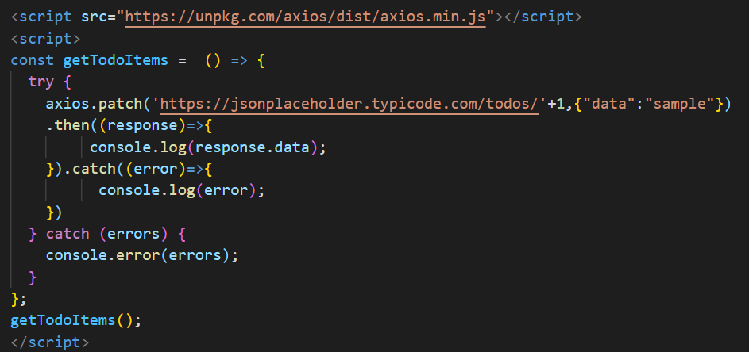
Patch Method

